Slide 1
DTS207TC Lab W4
Hejia Qiu
Assistant Professor in AIAC
Email: Hejia.Qiu@XJTLU.EDU.CN
Office Hour: D-5020
Tuesday & Thursday 2-4 PM

Slide 2
Week 4: XML
- Format convert
- XML structure and file parse
- Query
Week 5: ORM, HTML, Web Framework
Week 6: Hadoop

Slide 3
Objectives (2 Hour)
Learn how to convert CSV data to XML format.
Understand the XML data structure and its application scenarios.
Use Python programming to process XML data and perform simple data queries and operations.
Understand the core concepts of XPath and XQuery.

Slide 4
Step 1 (5 Minutes)
Save the provided market record CSV and trading pair basic information CSV to local files.
Make sure the Python environment is installed and the necessary libraries (such as pandas and lxml) are installed.

Slide 5
Step 2 (5 Minutes)
Import the pandas library. Use the pandas.read_csv() function to read two CSV files into DataFrames.
import pandas as pd
market_data_df = pd.read_csv('market_data.csv')
symbol_info_df = pd.read_csv('symbol_info.csv')

Slide 6
Step 3 (20 Minutes)
Use Python's xml.etree.ElementTree module or lxml library to create XML data structures.
Iterate over each row of the DataFrame and convert it into XML nodes and subnodes.
Save the generated XML data to a file for subsequent querying and manipulation.

Slide 7
import xml.etree.ElementTree as ET
# create root node
root = ET.Element('MarketData')
# Traverse the market record DataFrame and create child nodes
for index, row in market_data_df.iterrows():
record = ET.SubElement(root, 'Record')
timestamp = ET.SubElement(record, 'Timestamp')
timestamp.text = str(row['timestamp'])
symbol = ET.SubElement(record, 'Symbol')
symbol.text = str(row['symbol’])
a = ET.SubElement(record, 'AskPrice')
a.text = str(row['a'])
aq = ET.SubElement(record, 'AskQuantity')
aq.text = str(row['aq'])
b = ET.SubElement(record, 'BidPrice')
b.text = str(row['b'])
bq = ET.SubElement(record, 'BidQuantity')
bq.text = str(row['bq'])
# save XML data into local files
tree = ET.ElementTree(root)
tree.write('market_data.xml', encoding='utf-8', xml_declaration=True)
# Note: Only the XML conversion of the market record is shown here. The conversion of basic information of trading pairs is similar.

Slide 8
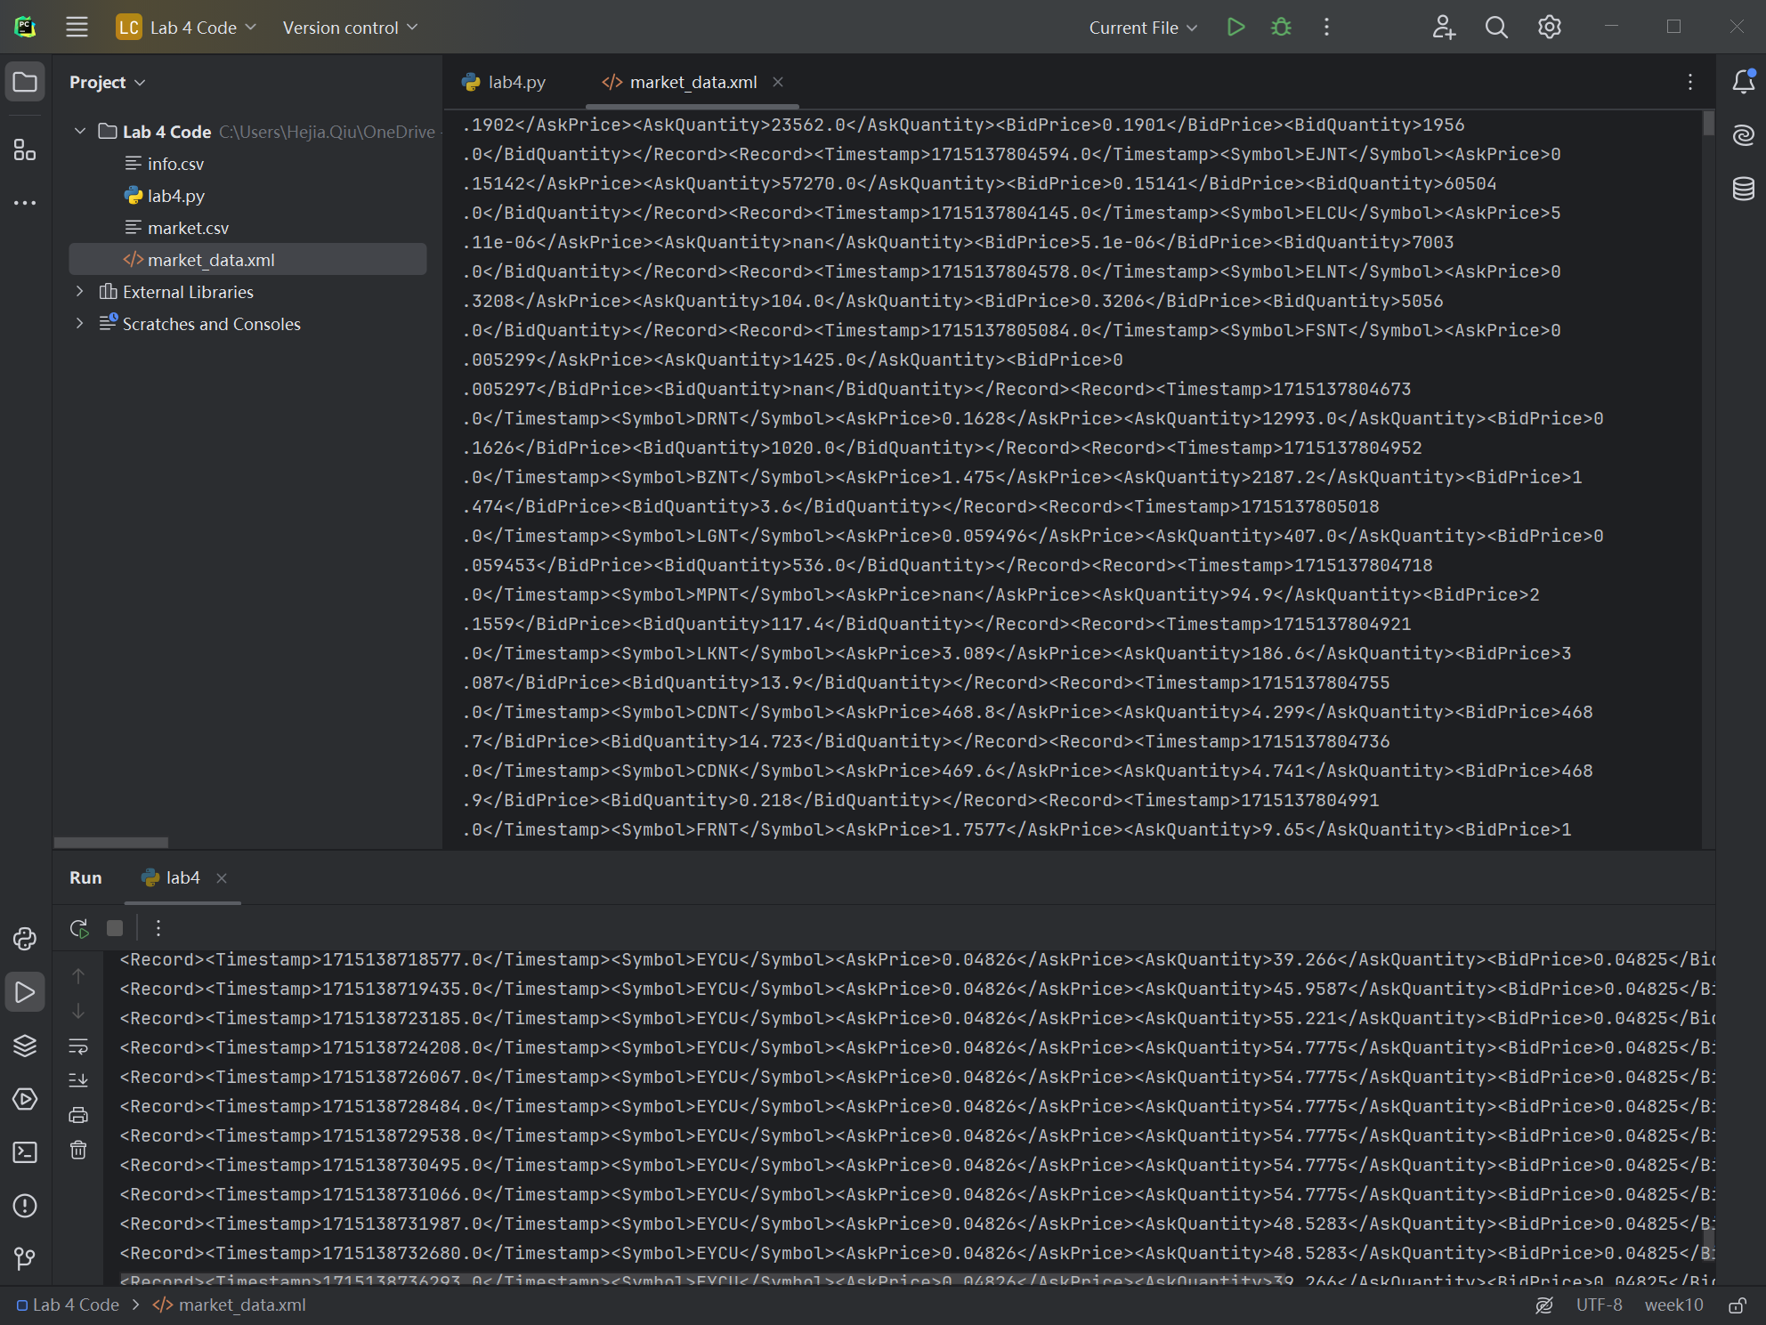
Hard to manually parse, we will do it later.

Slide 9
Step 3 (20 Minutes)
Try the SAX version to achieve same implementation.

Slide 10
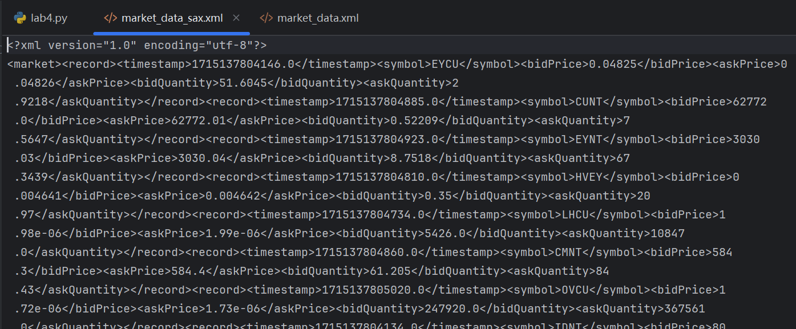
def w4_main_3_sax():
market_data_df = pd.read_csv('market.csv', header=0)
with open('market_data_sax.xml', 'w', encoding='utf-8') as f:
xml = saxutils.XMLGenerator(f, encoding='utf-8')
xml.startDocument()
xml.startElement('market', {})
for _, row in market_data_df.iterrows():
xml.startElement('record', {})
xml.startElement('timestamp', {})
xml.characters(str(row['timestamp']))
xml.endElement('timestamp')
xml.startElement('symbol', {})
xml.characters(str(row['symbol']))
xml.endElement('symbol')
xml.startElement('bidPrice', {})
xml.characters(str(row['b']))
xml.endElement('bidPrice')
xml.startElement('askPrice', {})
xml.characters(str(row['a']))
xml.endElement('askPrice')
xml.startElement('bidQuantity', {})
xml.characters(str(row['bq']))
xml.endElement('bidQuantity')
xml.startElement('askQuantity', {})
xml.characters(str(row['aq']))
xml.endElement('askQuantity')
xml.endElement('record')
xml.endElement('market')
xml.endDocument()
print("SAX write into：market_data_sax.xml")

Slide 11
Step 4 (25 Minutes)
Use the xml.etree.ElementTree module or the lxml library to parse XML files.
Perform simple data queries and operations, such as finding information about a specific trading pair based on a symbol, or calculating the best bid-ask spread at a certain point in time.

Slide 12
# Parsing XML files
tree = ET.parse('market_data.xml')
root = tree.getroot()
# Sample query: Find information about the EYCU trading pair
eycu_records = [record for record in root.findall('Record') if record.find('Symbol').text == 'EYCU']
for record in eycu_records:
print(ET.tostring(record, encoding='unicode'))
# Example operation: Calculate the best bid-ask spread for the first record
first_record = root.find('Record')
ask_price = float(first_record.find('AskPrice').text)
bid_price = float(first_record.find('BidPrice').text)
spread = ask_price - bid_price
print(f'Optimal buy-sell spread for the first record: {spread}’)
# Other queries and operations can be further designed, such as calculating the average price difference within a certain period of time.

Slide 13
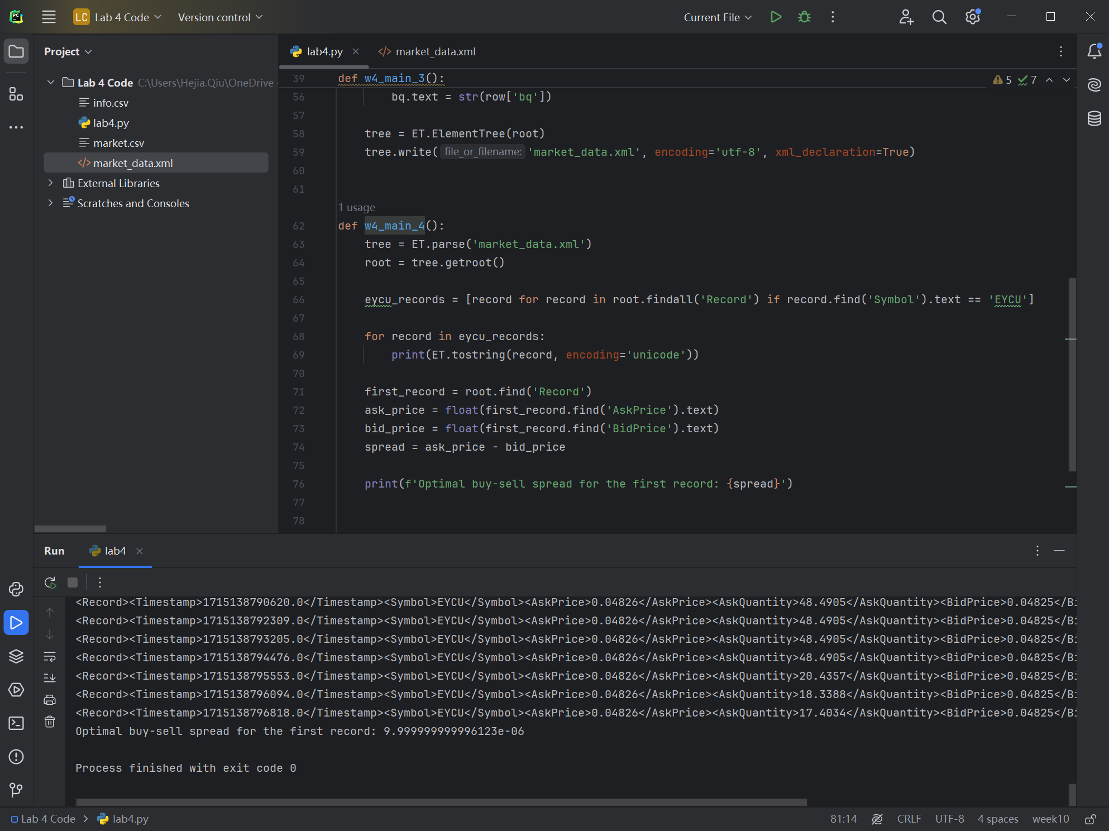

Slide 14
Step 4 (25 Minutes)
Use the xml.sax module library to parse XML files in a same way.
Perform simple data queries and operations, such as finding information about a specific trading pair based on a symbol, or calculating the best bid-ask spread at a certain point in time.

Slide 15
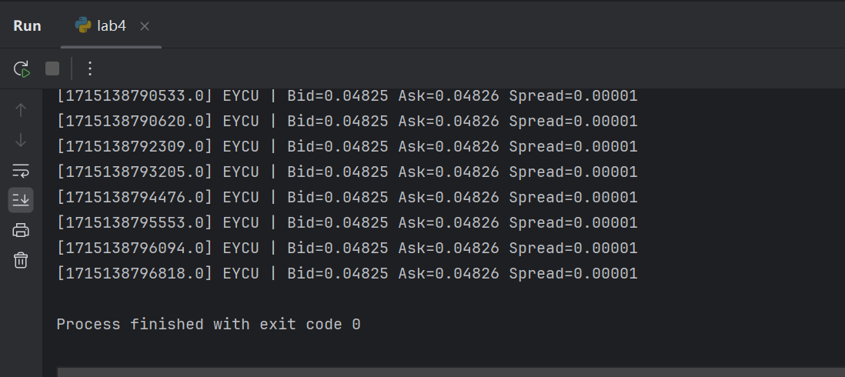

Slide 16

Step 5 (25 Minutes)
Install and use EditX to view and query XML files.
See the ‘install EditX.docx’.

Slide 17
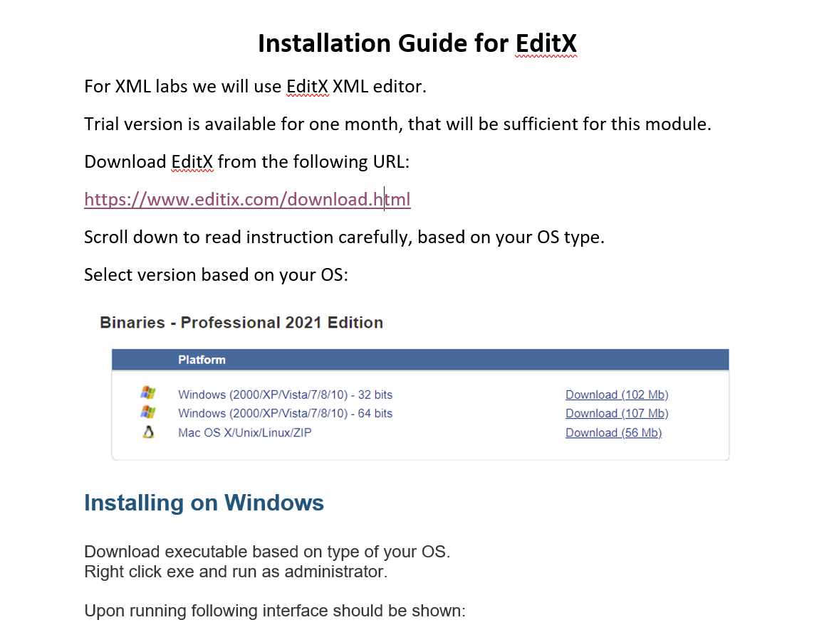

Slide 18
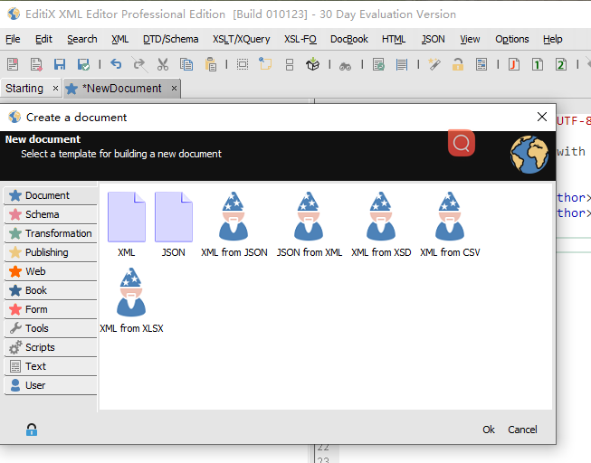
Step 5 (25 Minutes)
Use EditX tool to create an XML document and execute XPath and XQuery. The detailed EditX download and installation instructions have been uploaded to LMO.
Create your own XML document.
1
2
3

Slide 19
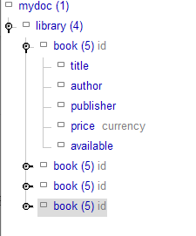
<?xml version="1.0" encoding="UTF-8"?>
<!-- New XML document created with EditiX XML Editor (http://www.editix.com) at Sun Nov 17 12:31:37 CST 2024 -->
<mydoc>
<library>
<book id="1" genre="Fiction" language="English" publication-year="2021">
<title>The Midnight Library</title>
<author>Matt Haig</author>
<publisher>Canongate Books</publisher>
<price currency="USD">20.99</price>
<available>Yes</available>
</book>
<book id="2" genre="Science" language="English" publication-year="2018">
<title>Brief Answers to the Big Questions</title>
<author>Stephen Hawking</author>
<publisher>Bantam Books</publisher>
<price currency="USD">15.00</price>
<available>No</available>
</book>
<book id="3" genre="Biography" language="Spanish" publication-year="2020">
<title>Una vida como ninguna otra</title>
<author>Gabriel García Márquez</author>
<publisher>Editorial Diana</publisher>
<price currency="MXN">250.00</price>
<available>No</available>
</book>
<book id="4" genre="Fantasy" language="German" publication-year="2010">
<title>Der Hobbit</title>
<author>J.R.R. Tolkien</author>
<publisher>Klett-Cotta</publisher>
<price currency="EUR">14.99</price>
<available>Yes</available>
</book>
</library>
</mydoc>
After entering the XML code, you can view the format of your data on the left side of EditX.

Slide 20
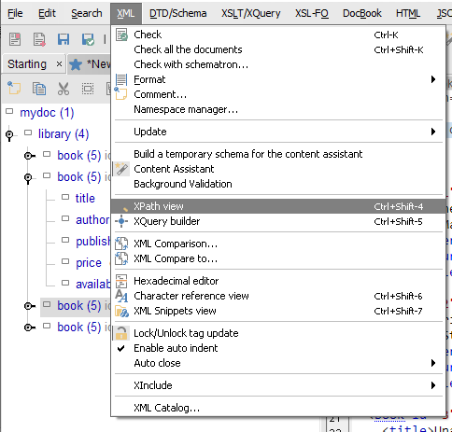

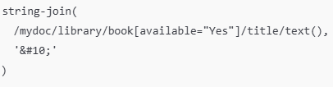
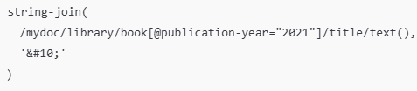
Utilize XPath to query the XML document, here are some examples.
1
1. Get all book titles
2. List available books
2
3. Retrieve titles of books published in 2021
Can you contemplate the following and investigate any additional inquiries you may have?

Slide 21
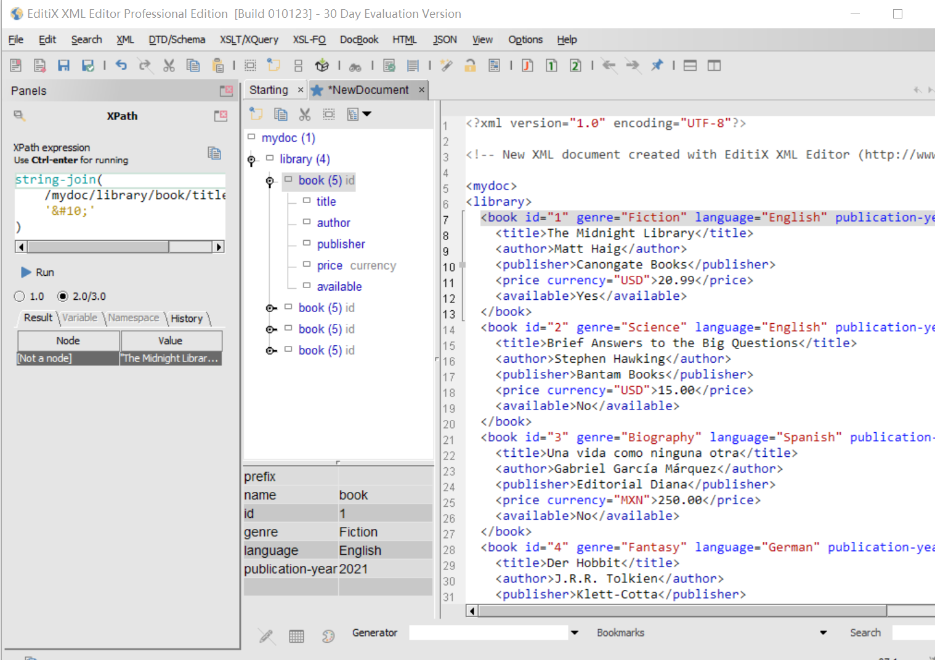
Utilize XPath to query the XML document, here are some examples.

Slide 22
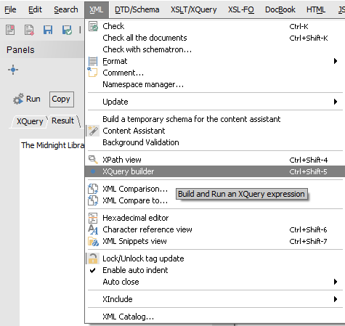

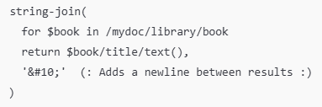

Utilize XQuery to query the XML document, here are some examples.
1
1. Find titles of books with a price in USD
2. Get all book titles
2
3. Get titles of books published in 2021
Can you contemplate the following and investigate any additional inquiries you may have?

Slide 23
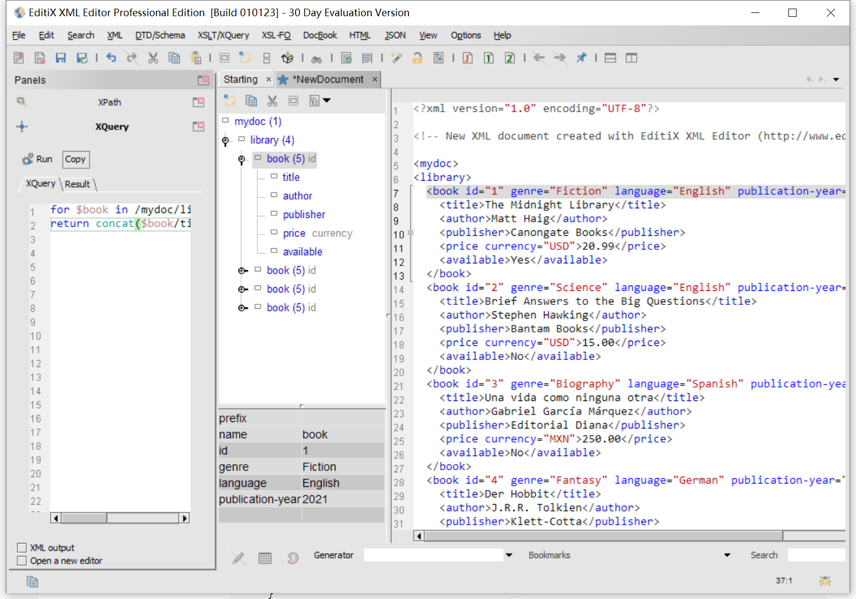
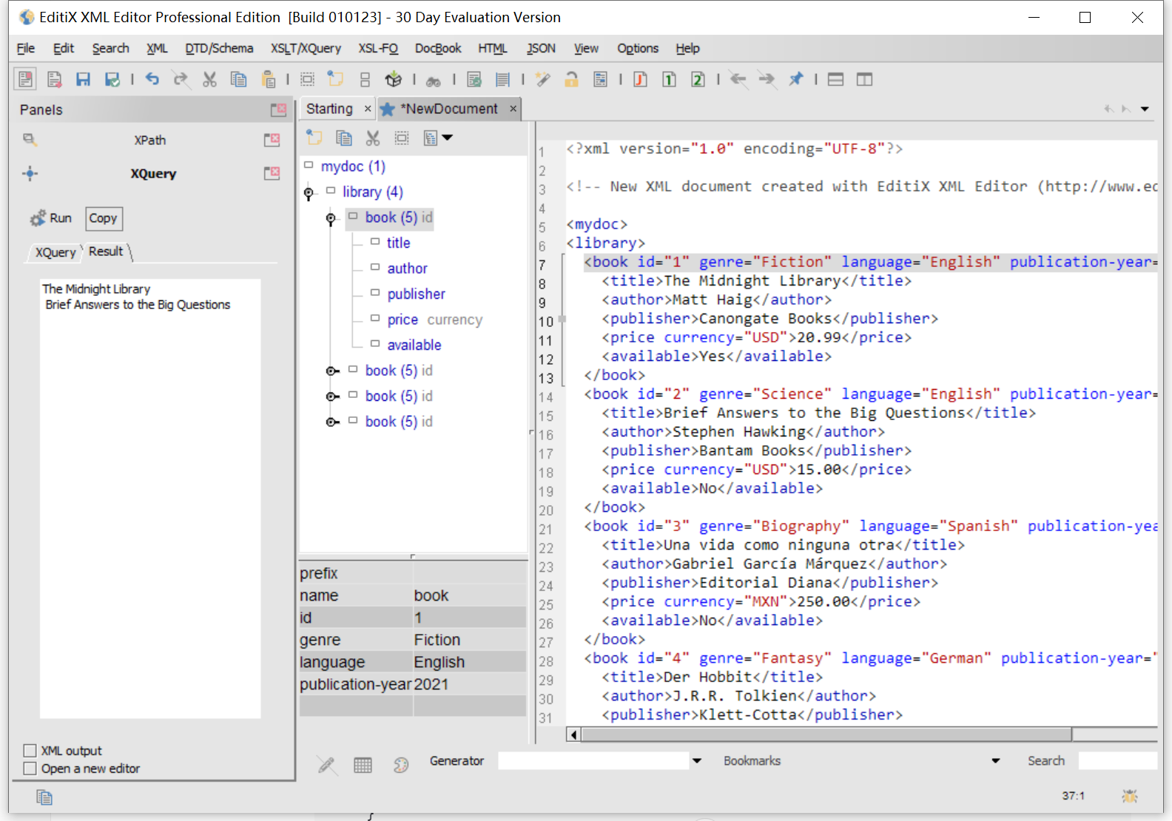
Utilize XQuery to query the XML document, here are some examples.

Slide 24
Step 6 (30 Minutes)
Use XPath and XQuery for advanced operations by yourself.

Slide 25
Find amount of EYCU trading records (AskQuantity > 50) by DOM/SAX
def w4_main_6():
tree = ET.parse('market_data.xml')
root = tree.getroot()
eycu_records = [record for record in root.findall('Record') if record.find('Symbol').text == 'EYCU']
count = 0
for record in eycu_records:
if float(record.find('AskQuantity').text) > 50:
print(ET.tostring(record, encoding='unicode'))
count += 1
print(f'Count of EYCU (AskQuantity > 50): {count}')

Slide 26
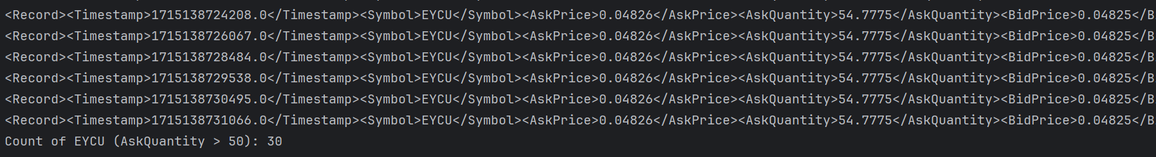
Find amount of EYCU trading records (AskQuantity > 50) by DOM/SAX

Slide 27
Find amount of EYCU trading records (AskQuantity > 50) by DOM/SAX
Print the book title by every genre in EditX

Slide 28
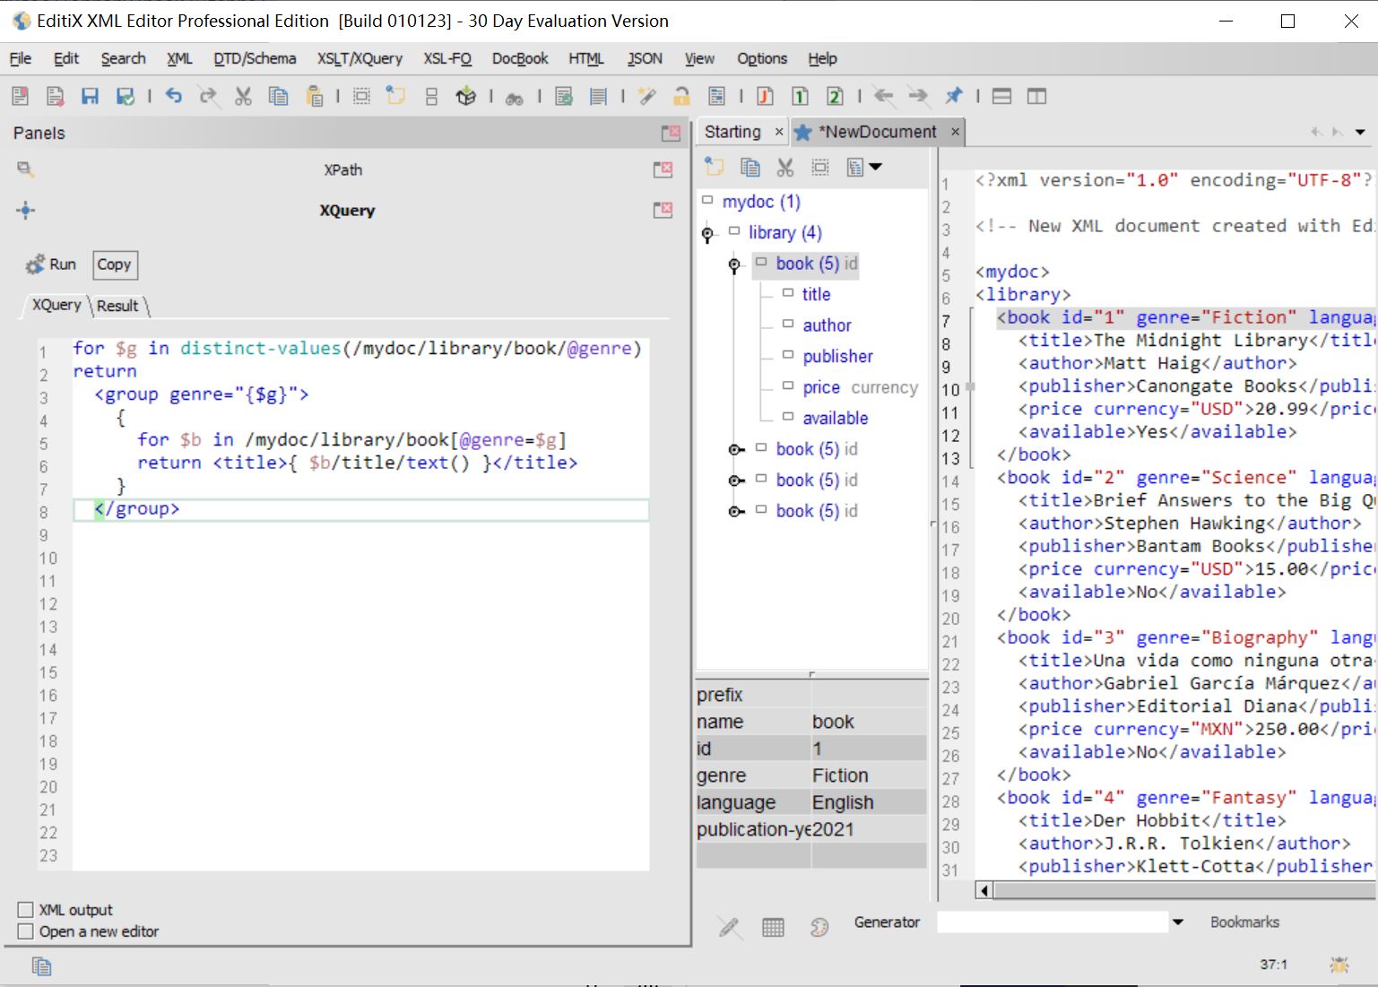
Find amount of EYCU trading records (AskQuantity > 50)
Print the book title by every genre

Slide 29
Find amount of EYCU trading records (AskQuantity > 50)
Print the book title by every genre
Transfer data structure: CSV <-> XML <-> JSON

Slide 30
Find amount of EYCU trading records (AskQuantity > 50)
Print the book title by every genre
Transfer data structure: CSV <-> XML <-> JSON
Query XML by SQL in Step 5: search all book info where year==2023, publisher==Addison-Wesley, and author==John Doe

Slide 31
DROP SCHEMA IF EXISTS pg CASCADE;
CREATE SCHEMA pg;
SET search_path = pg;
-- Create table
CREATE TABLE books (
id SERIAL PRIMARY KEY,
book_data xml
);
-- Insert more complex XML data
INSERT INTO books (book_data) VALUES
(xmlparse(DOCUMENT '<?xml version="1.0"?><book><title>Python Programming</title><author>John Doe</author><year>2023</year><publisher>O''Reilly Media</publisher><isbn>978-1-4919-4529-4</isbn></book>')),
(xmlparse(DOCUMENT '<?xml version="1.0"?><book><title>Java Programming</title><author>Jane Smith</author><year>2022</year><publisher>Addison-Wesley</publisher><isbn>978-0-13-468599-1</isbn></book>'));
-- Query more complex XML data with a condition
SELECT
(xpath('/book/title/text()', book_data))[1]::text AS title,
(xpath('/book/author/text()', book_data))[1]::text AS author,
(xpath('/book/year/text()', book_data))[1]::text AS year,
(xpath('/book/publisher/text()', book_data))[1]::text AS publisher,
(xpath('/book/isbn/text()', book_data))[1]::text AS isbn
FROM books
WHERE (xpath('/book/year/text()', book_data))[1]::text = '2023'
AND (xpath('/book/publisher/text()', book_data))[1]::text = 'Addison-Wesley'
AND (xpath('/book/author/text()', book_data))[1]::text = 'John Doe';
-- Clean up data (optional)
-- DELETE FROM books;
-- DROP TABLE books;

Slide 32
Find amount of EYCU trading records (AskQuantity > 50)
Print the book title by every genre
Transfer data structure: CSV <-> XML <-> JSON
Query XML by SQL in Step 5
Consider: Python or EditX, DOM or SAX?

Slide 33
Summary (10 Minutes)
Summarize the basic knowledge of XML and Python programming skills learned in this experiment.
Discuss the application scenarios and advantages of XML data structure in financial fields such as high-frequency foreign exchange trading.
Think about how to convert and interoperate XML data with other data formats (such as JSON, CSV, etc.).

Slide 34
Notes
The timestamp data in the experiment may need further processing (such as conversion to a readable date and time format) for more meaningful analysis and presentation.
In practical applications, the scale and complexity of XML data may be larger, and more efficient data processing methods and tools (such as the XPath query function of the lxml library) need to be considered.
The design of the XML data structure should meet specific business requirements and specifications to ensure the accuracy and readability of the data.

